Slide 1
File I/O

Slide 2
Streams
A stream is an object that enables the flow of data between a program and some I/O device or file
If the data flows into a program, then the stream is called an input stream
If the data flows out of a program, then the stream is called an output stream

Slide 3
Streams
Input streams can flow from the keyboard or from a file
System.in is an input stream that connects to the keyboard
Scanner keyboard = new Scanner(System.in);
Output streams can flow to a screen or to a file
System.out is an output stream that connects to the screen
System.out.println("Output stream");

Slide 4
Text Files and Binary Files
Files that are designed to be read by human beings, and that can be read or written with an editor are called text files
Text files can also be called ASCII files because the data they contain uses an ASCII encoding scheme
An advantage of text files is that the are usually the same on all computers, so that they can move from one computer to another

Slide 5
Text Files and Binary Files
Files that are designed to be read by programs and that consist of a sequence of binary digits are called binary files
Binary files are designed to be read on the same type of computer and with the same programming language as the computer that created the file
An advantage of binary files is that they are more efficient to process than text files
Unlike most binary files, Java binary files have the advantage of being platform independent also

Slide 6
Writing to a Text File
The class PrintWriter is a stream class that can be used to write to a text file
An object of the class PrintWriter has the methods print and println
These are similar to the System.out methods of the same names, but are used for text file output, not screen output

Slide 7
Writing to a Text File
All the file I/O classes that follow are in the package java.io, so a program that uses PrintWriter will start with a set of import statements:
import java.io.PrintWriter;
import java.io.FileOutputStream;
import java.io.FileNotFoundException;
The class PrintWriter has no constructor that takes a file name as its argument
It uses another class, FileOutputStream, to convert a file name to an object that can be used as the argument to its (the PrintWriter) constructor

Slide 8
Writing to a Text File
A stream of the class PrintWriter is created and connected to a text file for writing as follows:
PrintWriter outputStreamName;
outputStreamName = new PrintWriter(new
FileOutputStream(FileName));
The class FileOutputStream takes a string representing the file name as its argument
The class PrintWriter takes the anonymous FileOutputStream object as its argument

Slide 9
Writing to a Text File
This produces an object of the class PrintWriter that is connected to the file FileName
The process of connecting a stream to a file is called opening the file
If the file already exists, then doing this causes the old contents to be lost
If the file does not exist, then a new, empty file named FileName is created
After doing this, the methods print and println can be used to write to the file

Slide 10
Writing to a Text File
When a text file is opened in this way, a FileNotFoundException can be thrown
In this context it actually means that the file could not be created
This type of exception can also be thrown when a program attempts to open a file for reading and there is no such file
It is therefore necessary to enclose this code in exception handling blocks
The file should be opened inside a try block
A catch block should catch and handle the possible exception
The variable that refers to the PrintWriter object should be declared outside the block (and initialized to null) so that it is not local to the block

Slide 11
Writing to a Text File
When a program is finished writing to a file, it should always close the stream connected to that file
outputStreamName.close();
This allows the system to release any resources used to connect the stream to the file
If the program does not close the file before the program ends, Java will close it automatically, but it is safest to close it explicitly

Slide 12
Writing to a Text File
Output streams connected to files are usually buffered
Rather than physically writing to the file as soon as possible, the data is saved in a temporary location (buffer)
When enough data accumulates, or when the method flush is invoked, the buffered data is written to the file all at once
This is more efficient, since physical writes to a file can be slow

Slide 13
Writing to a Text File
The method close invokes the method flush, thus insuring that all the data is written to the file
If a program relies on Java to close the file, and the program terminates abnormally, then any output that was buffered may not get written to the file
Also, if a program writes to a file and later reopens it to read from the same file, it will have to be closed first anyway
The sooner a file is closed after writing to it, the less likely it is that there will be a problem

Slide 14
File Names
The rules for how file names should be formed depend on a given operating system, not Java
When a file name is given to a java constructor for a stream, it is just a string, not a Java identifier (e.g., "fileName.txt")
Any suffix used, such as .txt has no special meaning to a Java program

Slide 15
A File Has Two Names
Every input file and every output file used by a program has two names:
The real file name used by the operating system
The name of the stream that is connected to the file
The actual file name is used to connect to the stream
The stream name serves as a temporary name for the file, and is the name that is primarily used within the program

Slide 16
IOException
When performing file I/O there are many situations in which an exception, such as FileNotFoundException, may be thrown
Many of these exception classes are subclasses of the class IOException
The class IOException is the root class for a variety of exception classes having to do with input and/or output
These exception classes are all checked exceptions
Therefore, they must be caught or declared in a throws clause

Slide 17
Unchecked Exceptions
In contrast, the exception classes NoSuchElementException, InputMismatchException, and IllegalStateException are all unchecked exceptions
Unchecked exceptions are not required to be caught or declared in a throws clause

Slide 18
Pitfall: a try Block is a Block
Since opening a file can result in an exception, it should be placed inside a try block
If the variable for a PrintWriter object needs to be used outside that block, then the variable must be declared outside the block
Otherwise it would be local to the block, and could not be used elsewhere
If it were declared in the block and referenced elsewhere, the compiler will generate a message indicating that it is an undefined identifier

Slide 19
Appending to a Text File
To create a PrintWriter object and connect it to a text file for appending, a second argument, set to true, must be used in the constructor for the FileOutputStream object
outputStreamName = new PrintWriter(new FileOutputStream(FileName, true));
After this statement, the methods print, println and/or printf can be used to write to the file
The new text will be written after the old text in the file

Slide 20
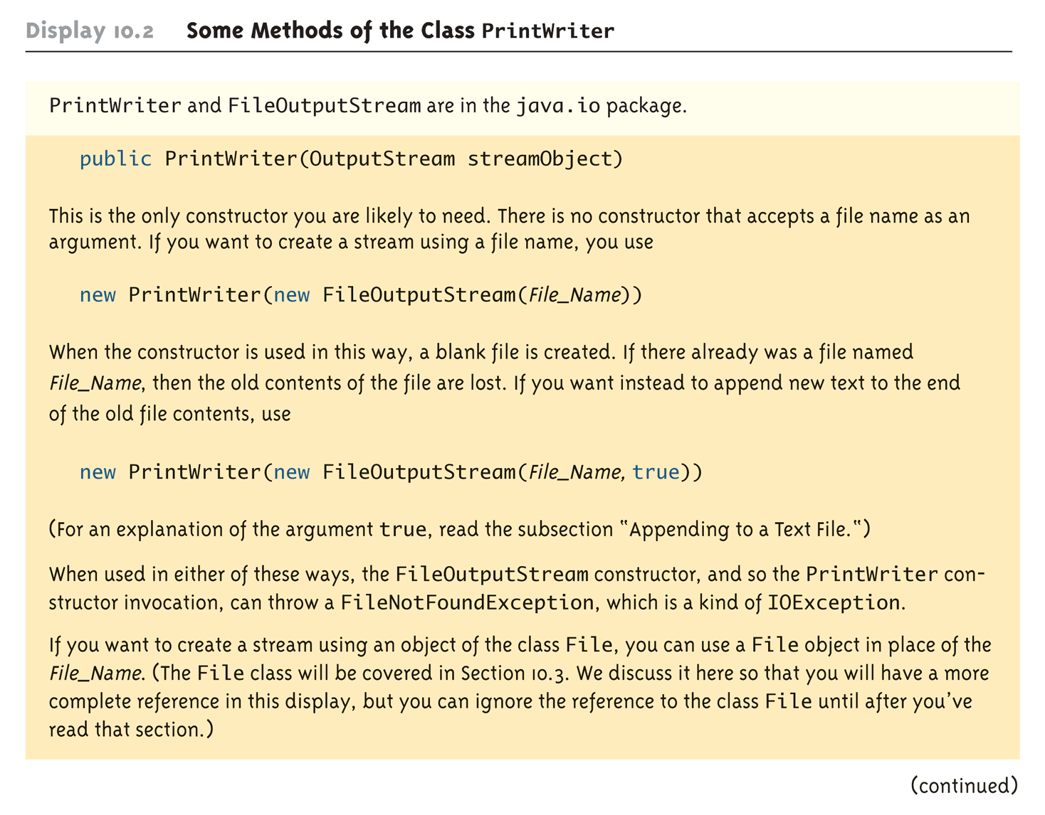
Some Methods of the Class PrintWriter (Part 1 of 3)

Slide 21
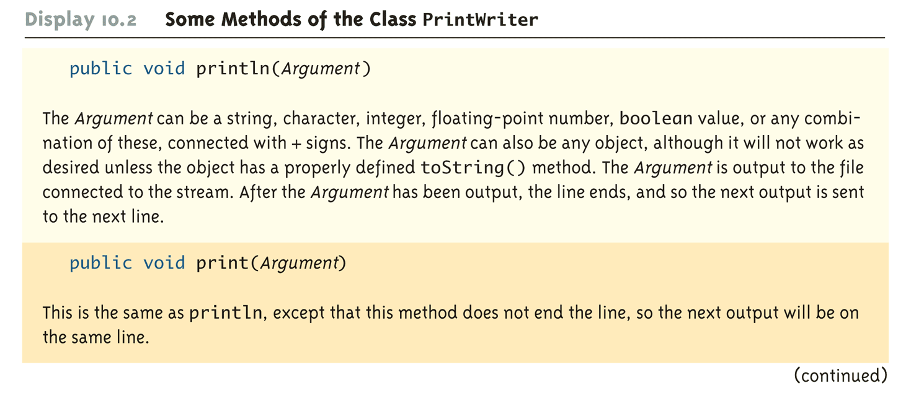
Some Methods of the Class PrintWriter (Part 2 of 3)

Slide 22
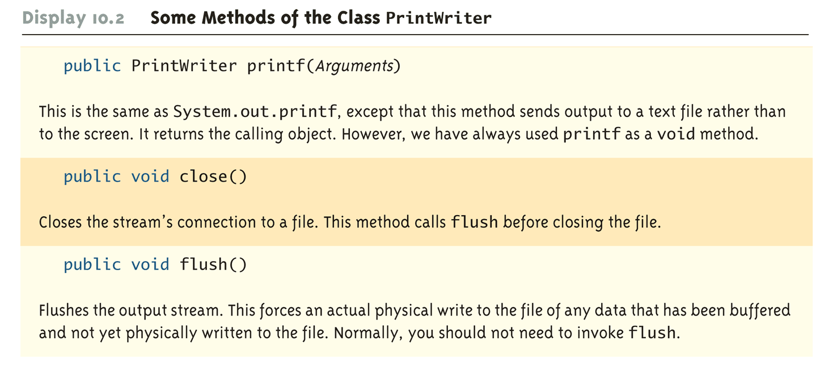
Some Methods of the Class PrintWriter (Part 3 of 3)

Slide 23
Reading From a Text File Using Scanner
The class Scanner can be used for reading from the keyboard as well as reading from a text file
Simply replace the argument System.in (to the Scanner constructor) with a suitable stream that is connected to the text file
Scanner StreamObject =
new Scanner(new FileInputStream(FileName));
Methods of the Scanner class for reading input behave the same whether reading from the keyboard or reading from a text file
For example, the nextInt and nextLine methods

Slide 24
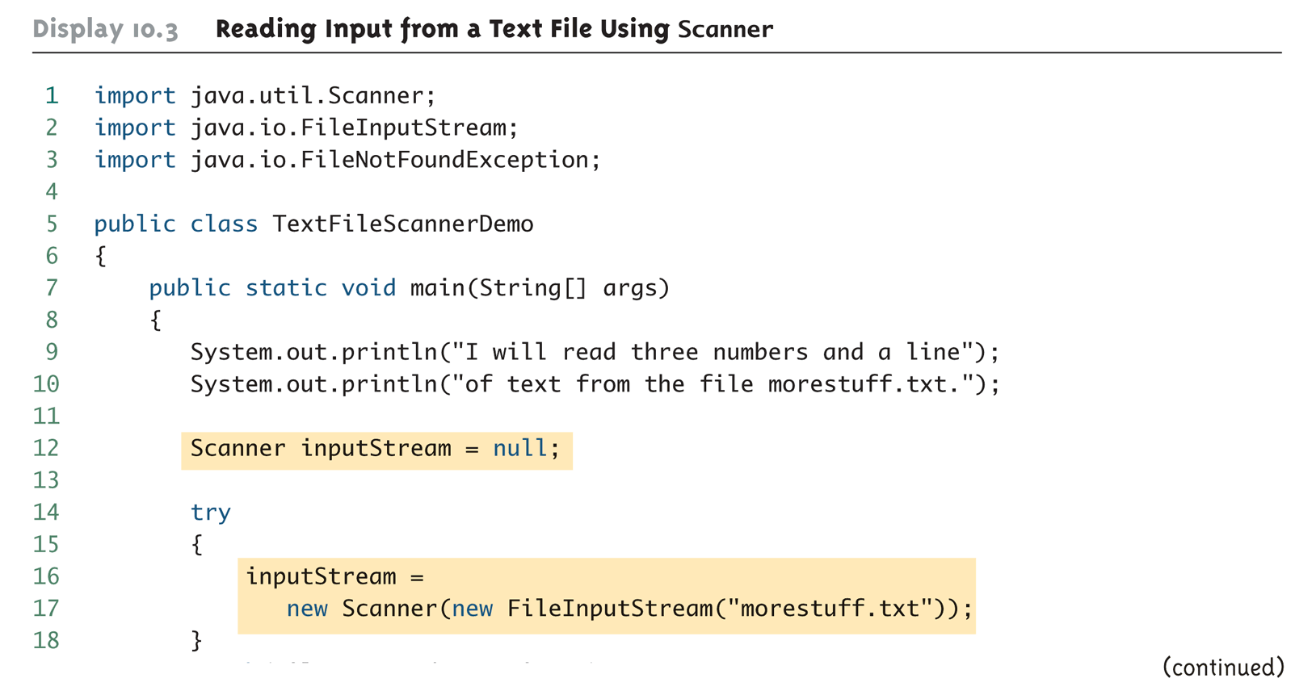
Reading Input from a Text File Using Scanner (Part 1 of 4)

Slide 25
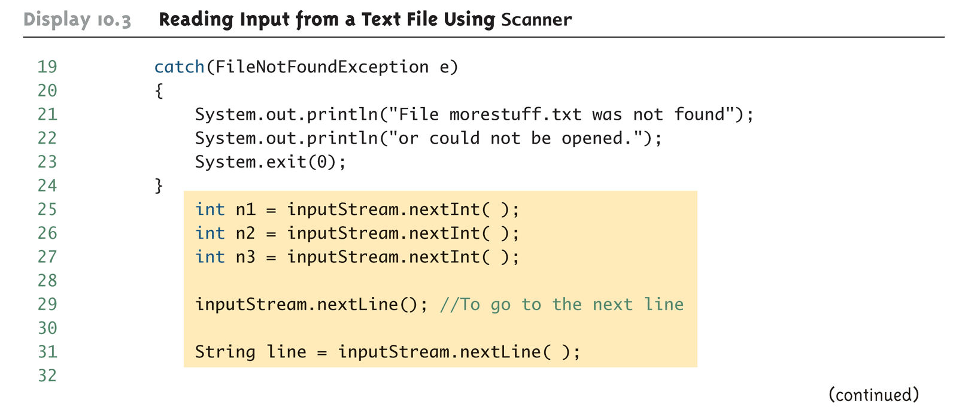
Reading Input from a Text File Using Scanner (Part 2 of 4)

Slide 26
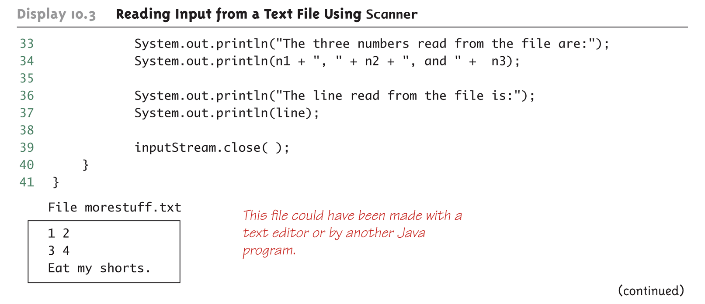
Reading Input from a Text File Using Scanner (Part 3 of 4)

Slide 27
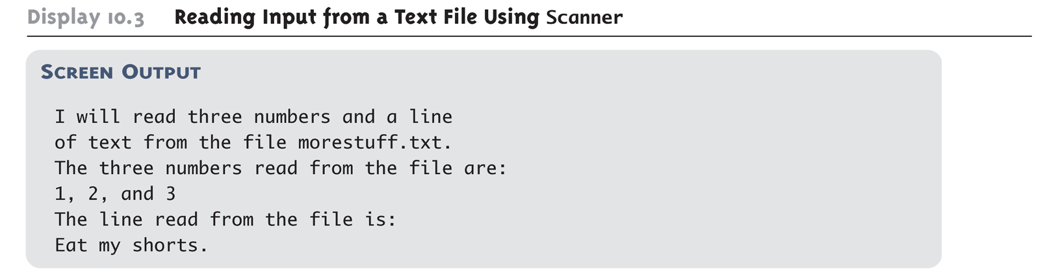
Reading Input from a Text File Using Scanner (Part 4 of 4)

Slide 28
Testing for the End of a Text File with Scanner
A program that tries to read beyond the end of a file using methods of the Scanner class will cause an exception to be thrown
However, instead of having to rely on an exception to signal the end of a file, the Scanner class provides methods such as hasNextInt and hasNextLine
These methods can also be used to check that the next token to be input is a suitable element of the appropriate type

Slide 29
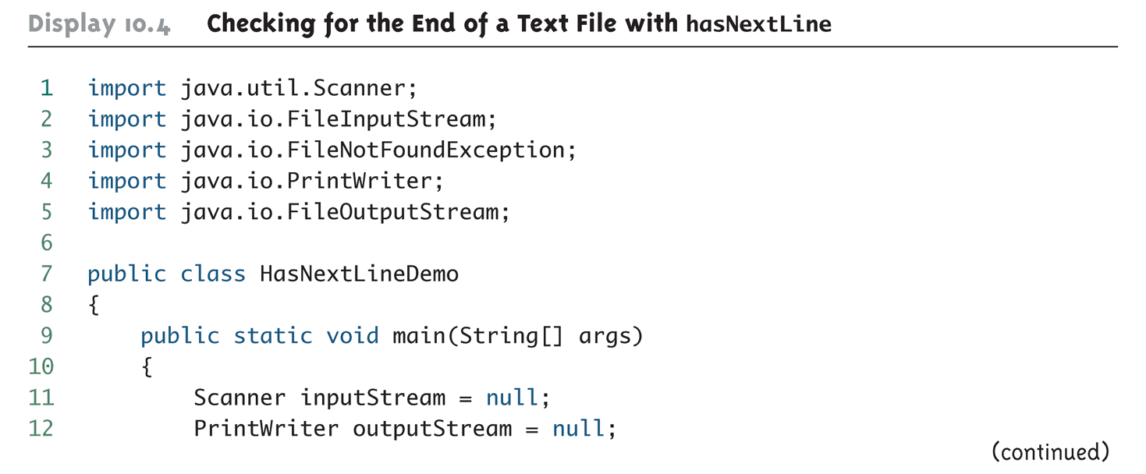
Checking for the End of a Text File with hasNextLine (Part 1 of 4)

Slide 30
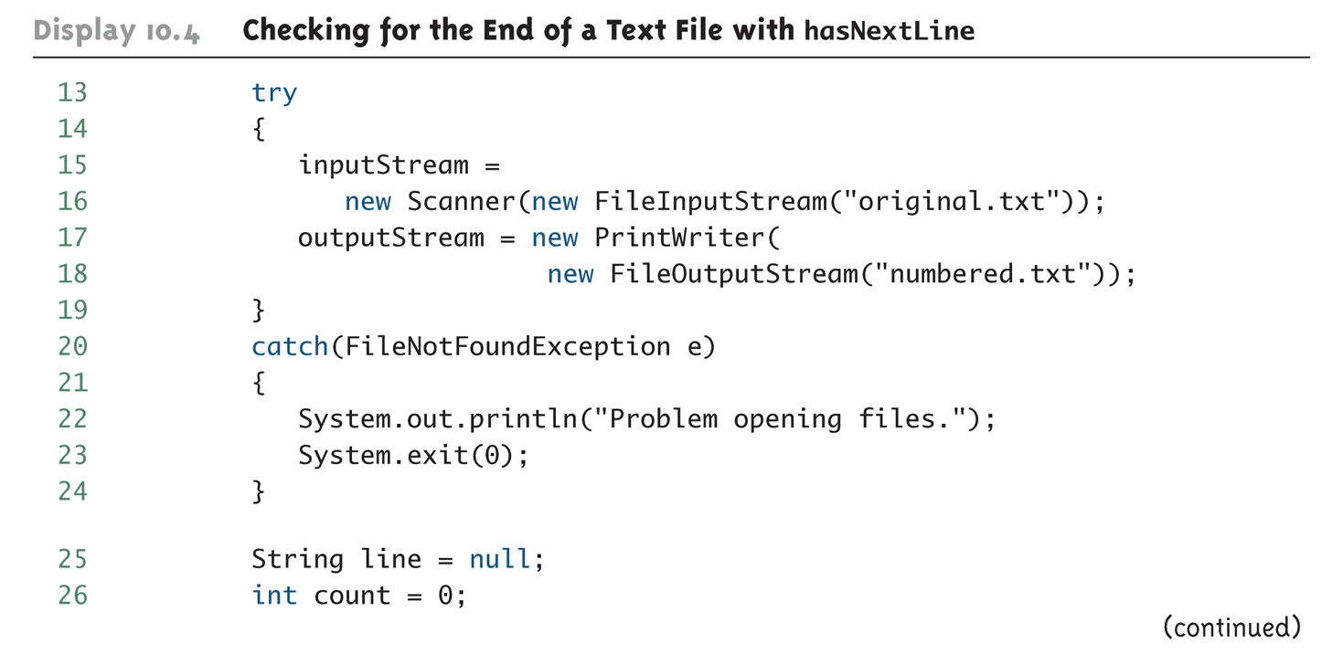
Checking for the End of a Text File with hasNextLine (Part 2 of 4)

Slide 31
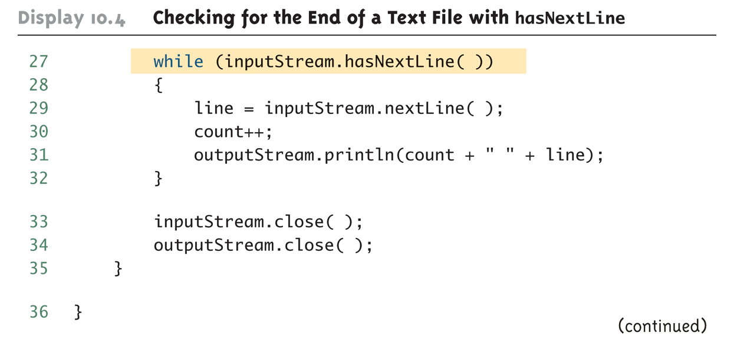
Checking for the End of a Text File with hasNextLine (Part 3 of 4)

Slide 32
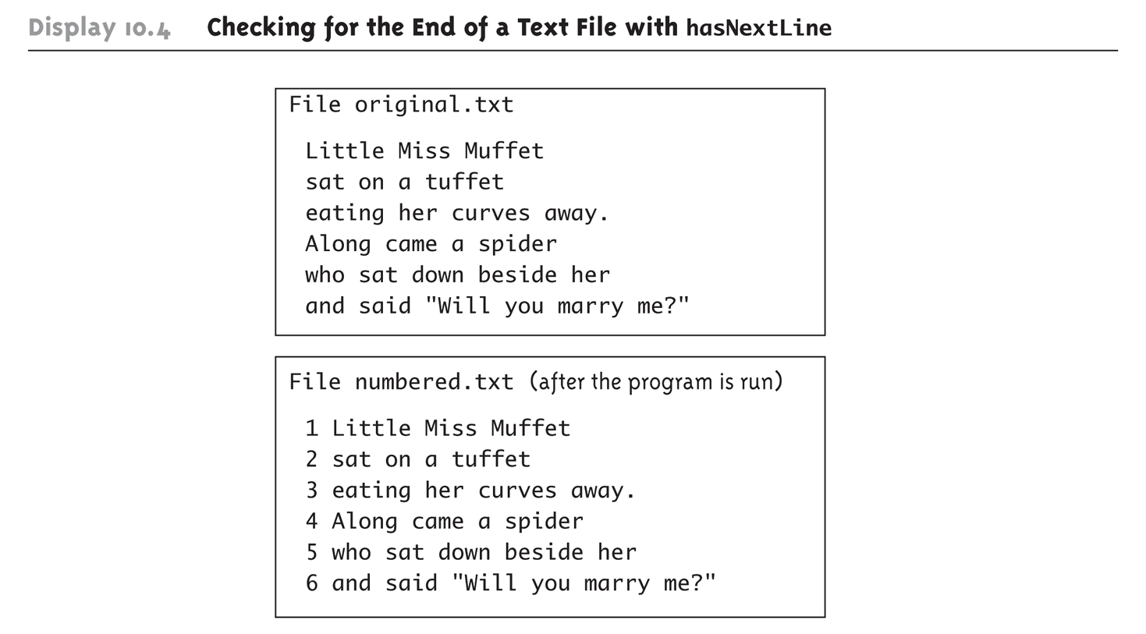
Checking for the End of a Text File with hasNextLine (Part 4 of 4)

Slide 33
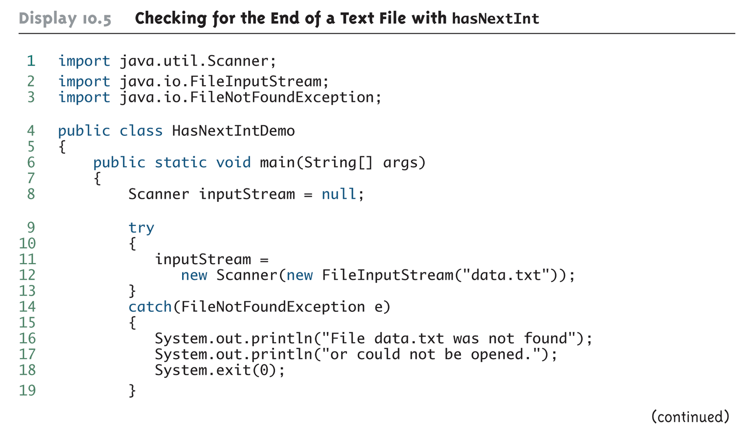
Checking for the End of a Text File with hasNextInt (Part 1 of 2)

Slide 34
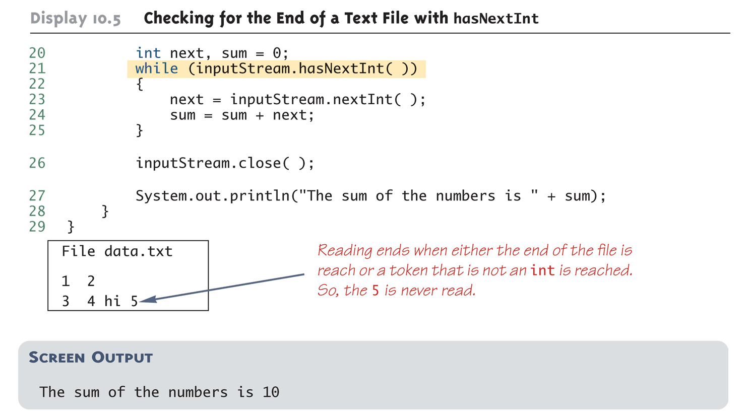
Checking for the End of a Text File with hasNextInt (Part 2 of 2)

Slide 35
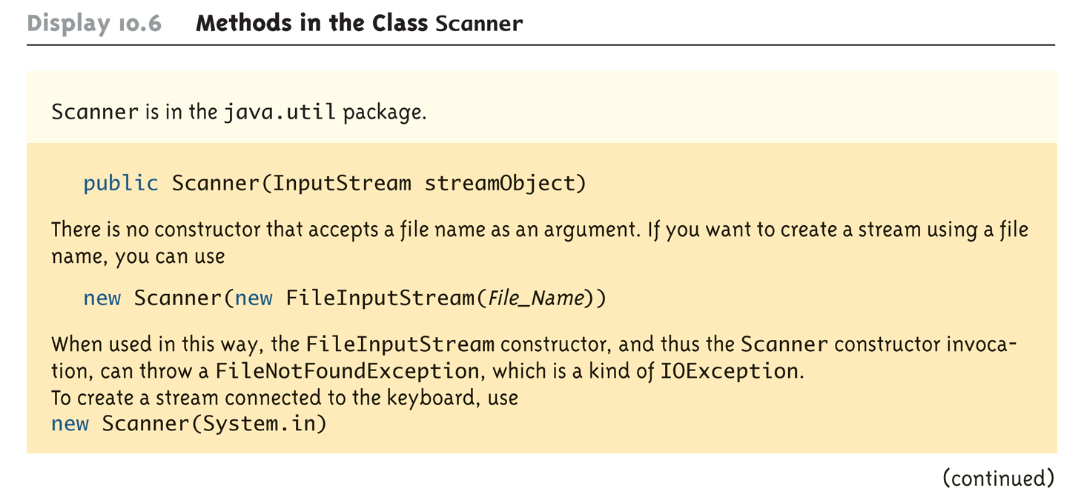
Methods in the Class Scanner (Part 1 of 11)

Slide 36
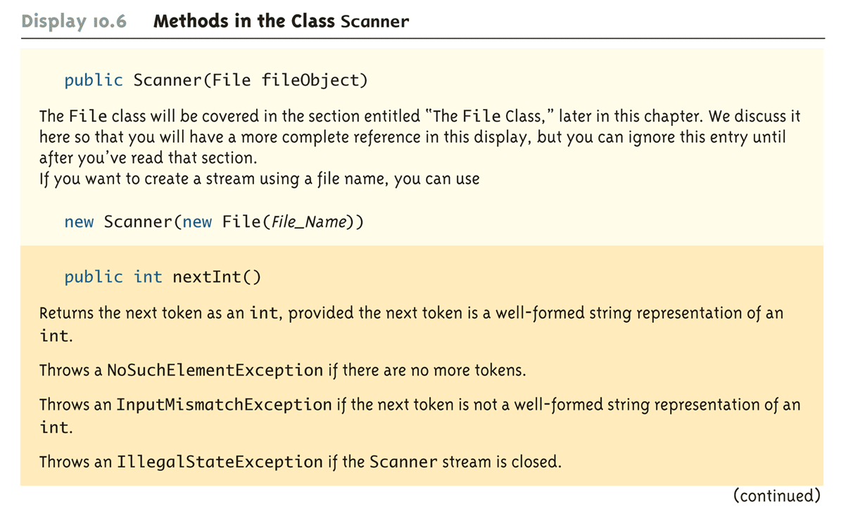
Methods in the Class Scanner (Part 2 of 11)

Slide 37
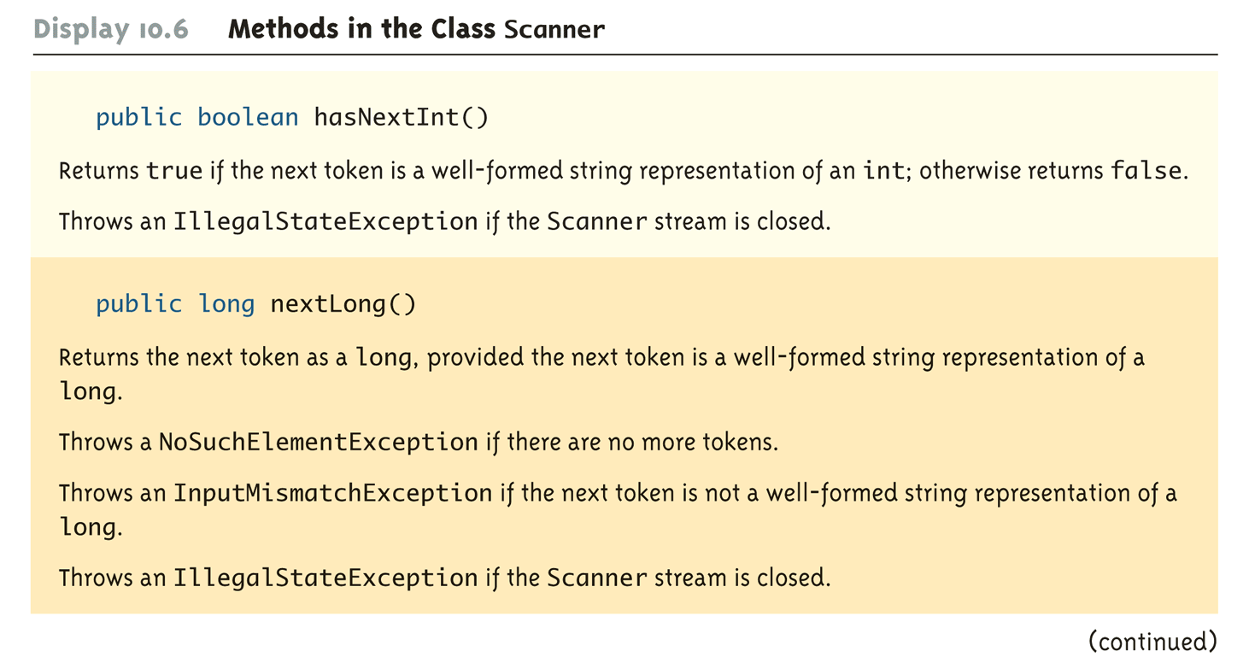
Methods in the Class Scanner (Part 3 of 11)

Slide 38
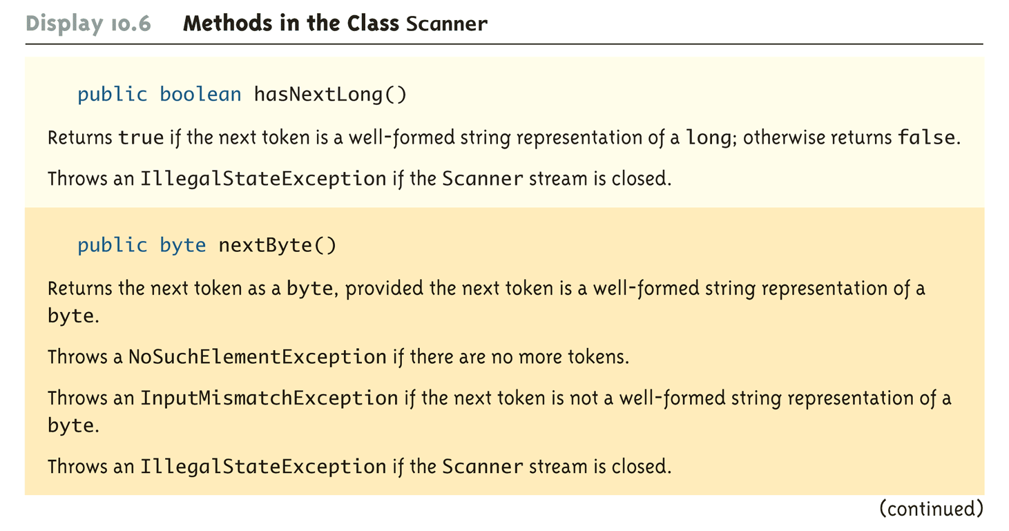
Methods in the Class Scanner (Part 4 of 11)

Slide 39
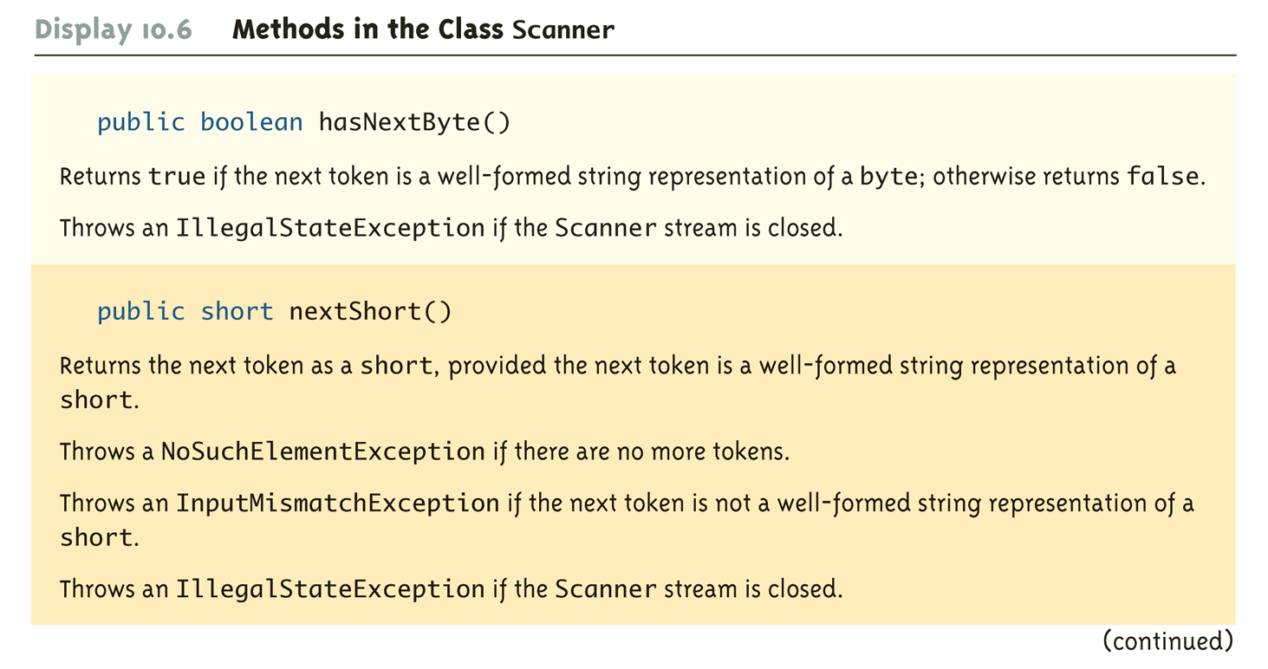
Methods in the Class Scanner (Part 5 of 11)

Slide 40
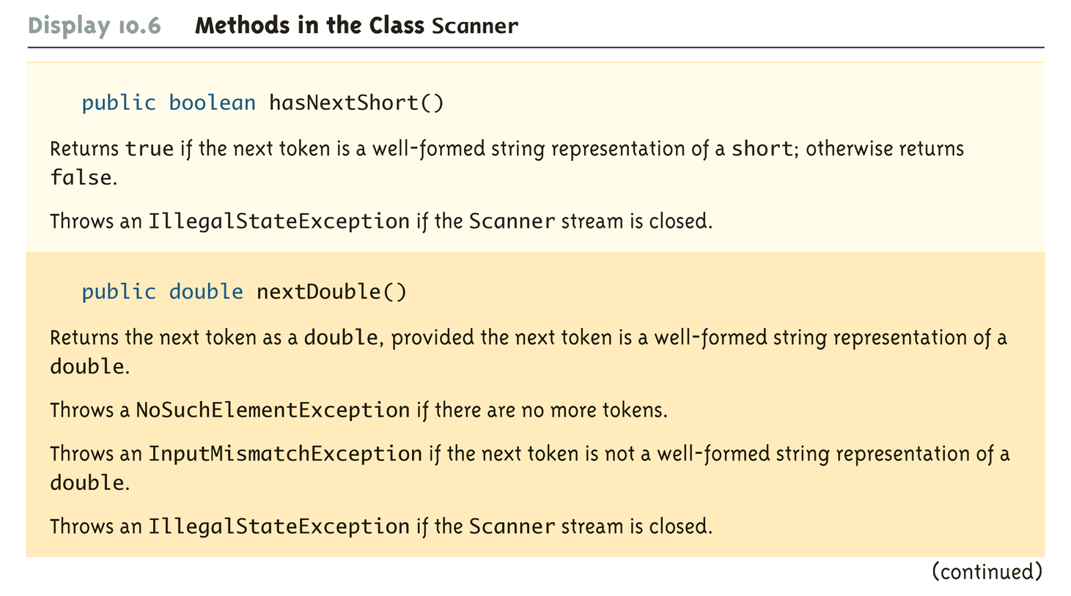
Methods in the Class Scanner (Part 6 of 11)

Slide 41
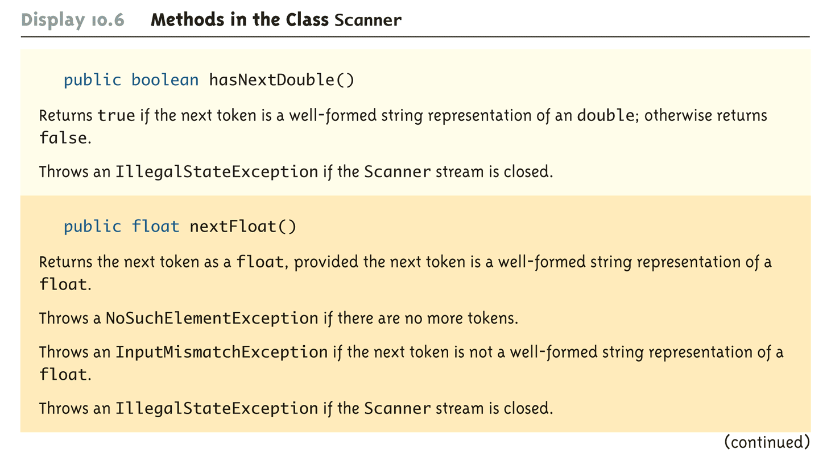
Methods in the Class Scanner (Part 7 of 11)

Slide 42
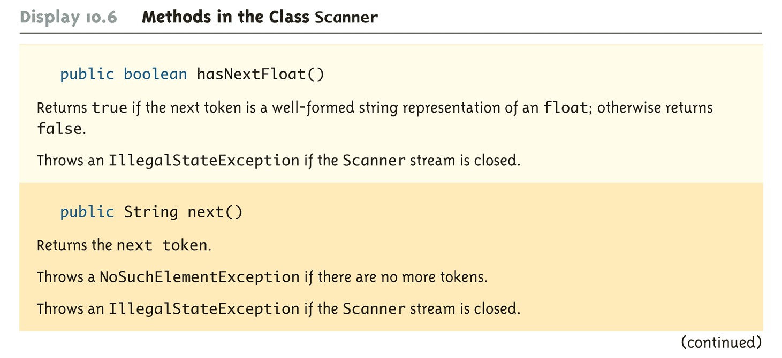
Methods in the Class Scanner (Part 8 of 11)

Slide 43
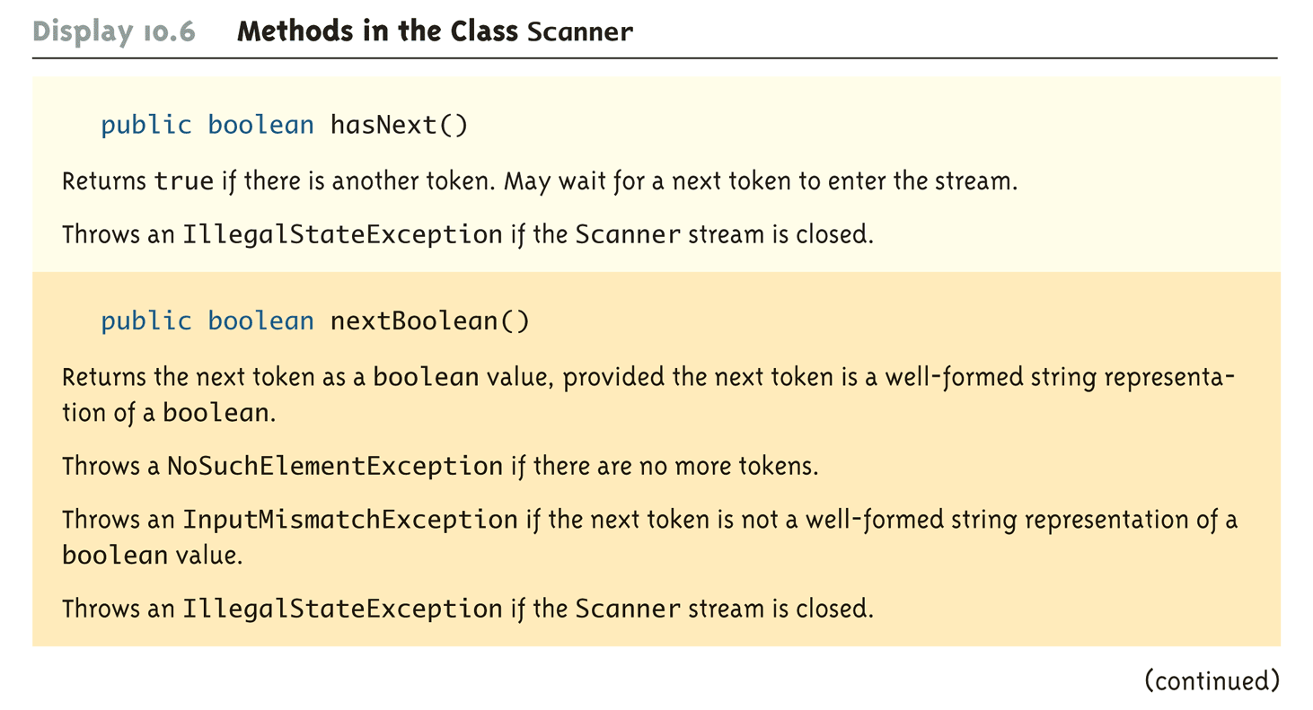
Methods in the Class Scanner (Part 9 of 11)

Slide 44
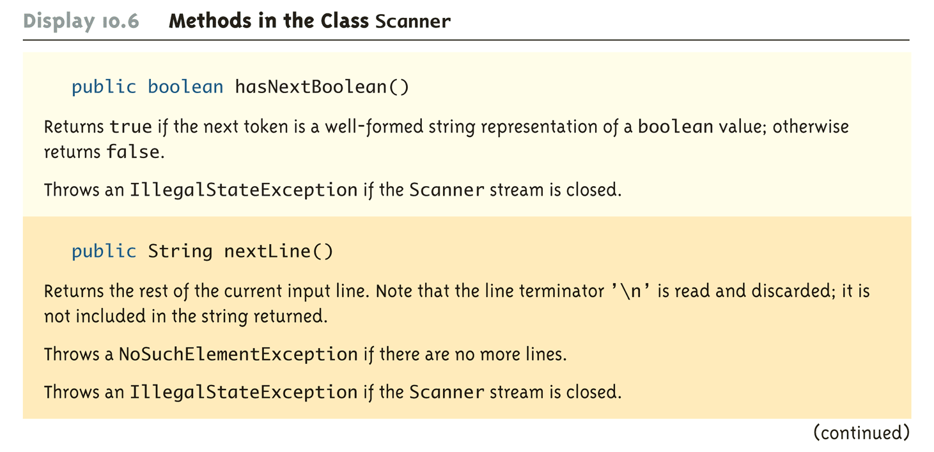
Methods in the Class Scanner (Part 10 of 11)

Slide 45
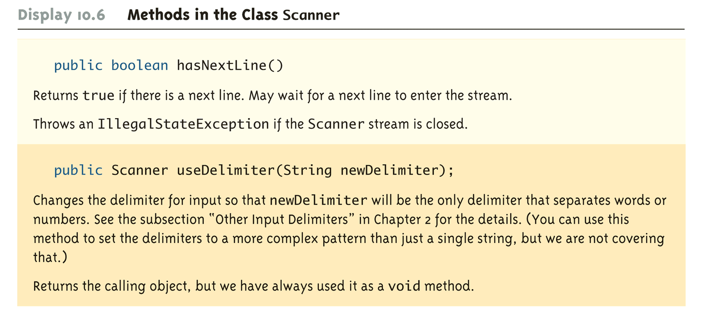
Methods in the Class Scanner (Part 11 of 11)

Slide 46
Reading From a Text File Using BufferedReader
The class BufferedReader is a stream class that can be used to read from a text file
An object of the class BufferedReader has the methods read and readLine
A program using BufferedReader, like one using PrintWriter, will start with a set of import statements:
import java.io.BufferedReader;
import java.io.FileReader;
import java.io.FileNotFoundException;
import java.io.IOException;

Slide 47
Reading From a Text File Using BufferedReader
Like the classes PrintWriter and Scanner, BufferedReader has no constructor that takes a file name as its argument
It needs to use another class, FileReader, to convert the file name to an object that can be used as an argument to its (the BufferedReader) constructor
A stream of the class BufferedReader is created and connected to a text file as follows:
BufferedReader readerObject;
readerObject = new BufferedReader(new
FileReader(FileName));
This opens the file for reading

Slide 48
Reading From a Text File
After these statements, the methods read and readLIne can be used to read from the file
The readLine method is the same method used to read from the keyboard, but in this case it would read from a file
The read method reads a single character, and returns a value (of type int) that corresponds to the character read
Since the read method does not return the character itself, a type cast must be used:
char next = (char)(readerObject.read());

Slide 49
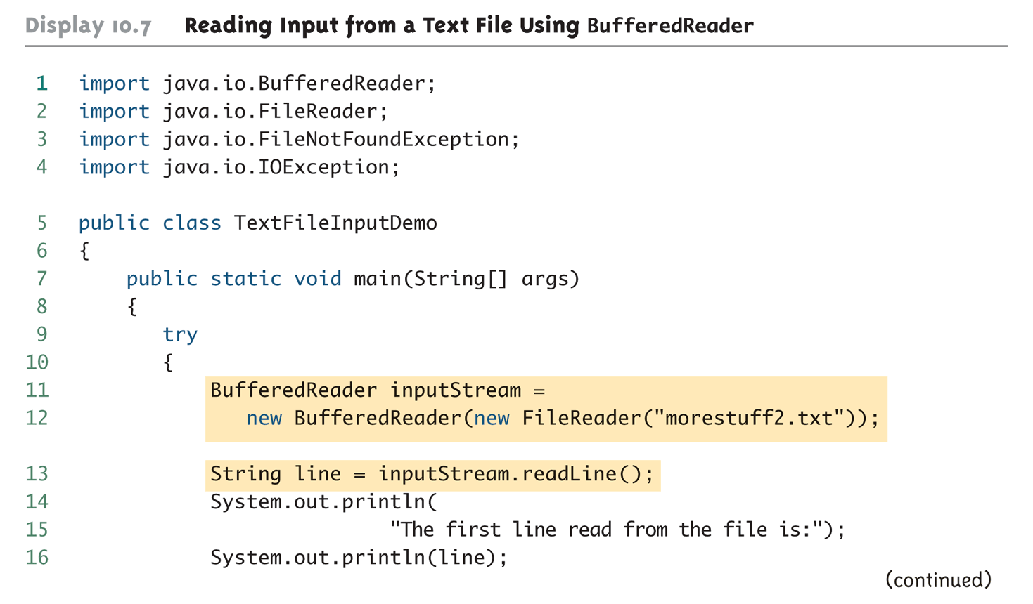
Reading Input from a Text File Using BufferedReader (Part 1 of 3)

Slide 50
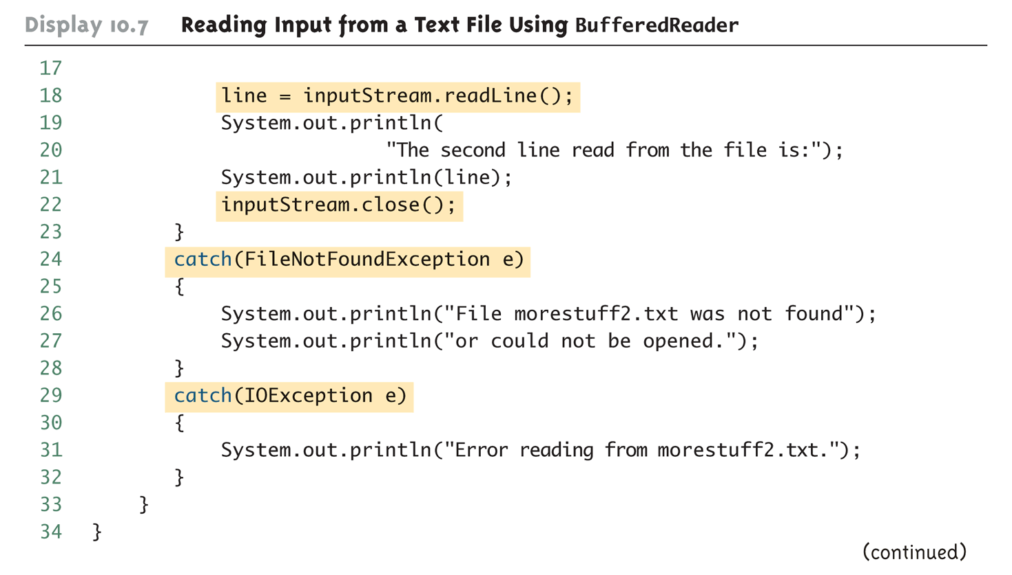
Reading Input from a Text File Using BufferedReader (Part 2 of 3)

Slide 51
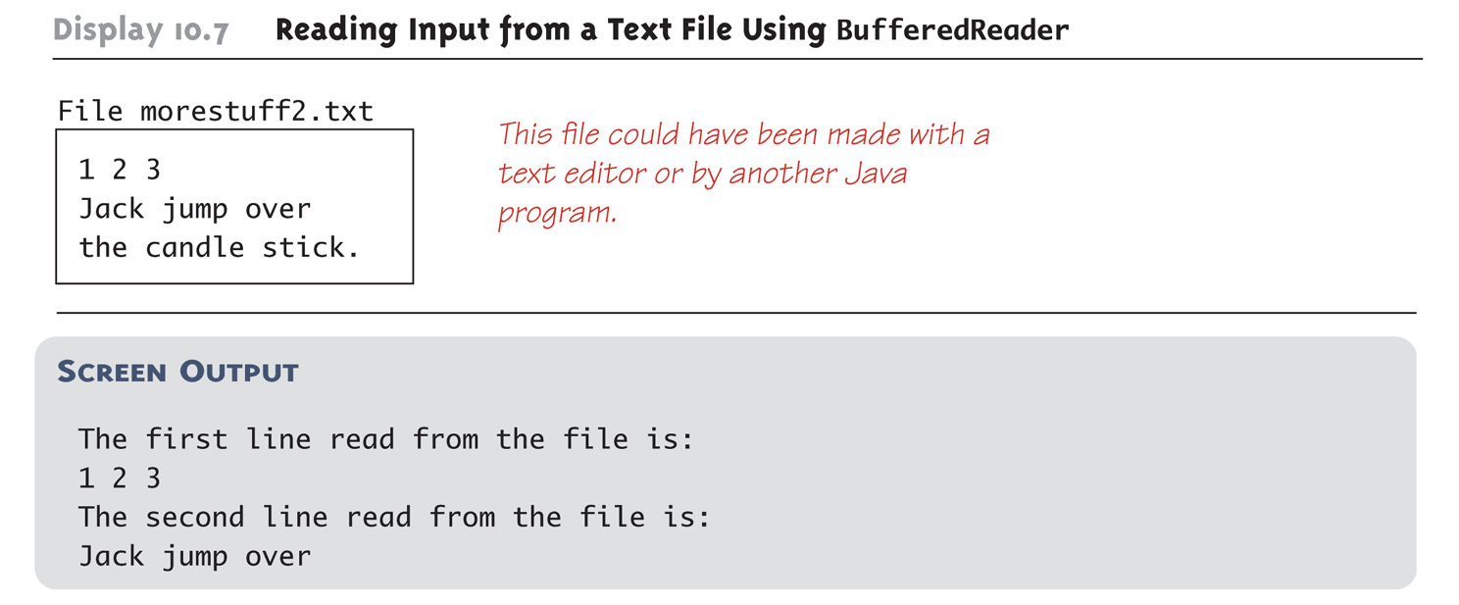
Reading Input from a Text File Using BufferedReader (Part 3 of 3)

Slide 52
Reading From a Text File
A program using a BufferedReader object in this way may throw two kinds of exceptions
An attempt to open the file may throw a FileNotFoundException (which in this case has the expected meaning)
An invocation of readLine may throw an IOException
Both of these exceptions should be handled

Slide 53
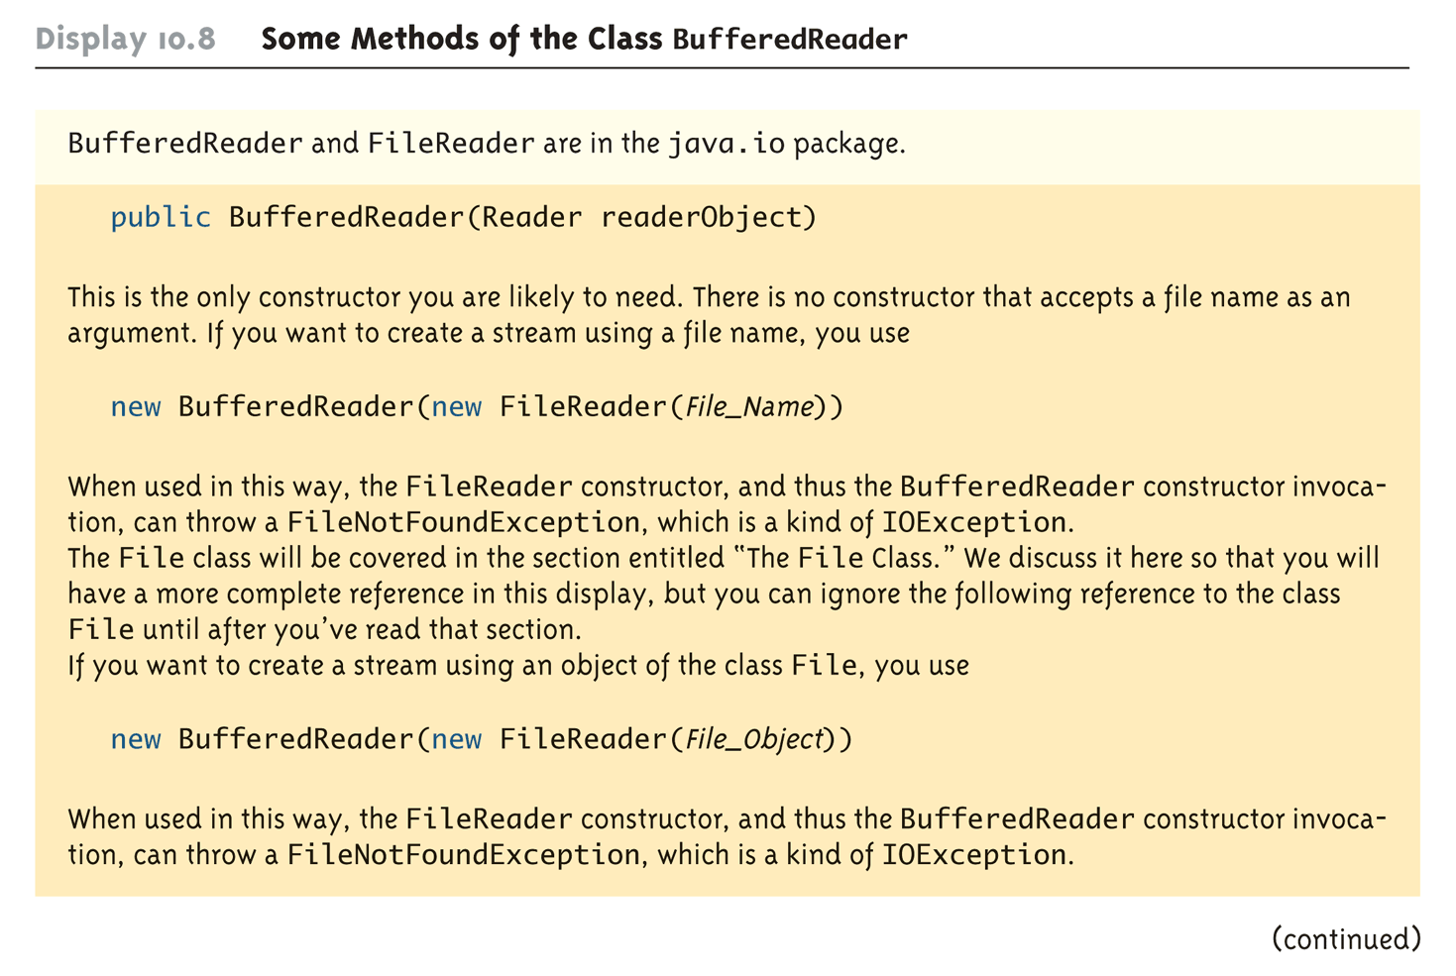
Some Methods of the Class BufferedReader (Part 1 of 2)

Slide 54
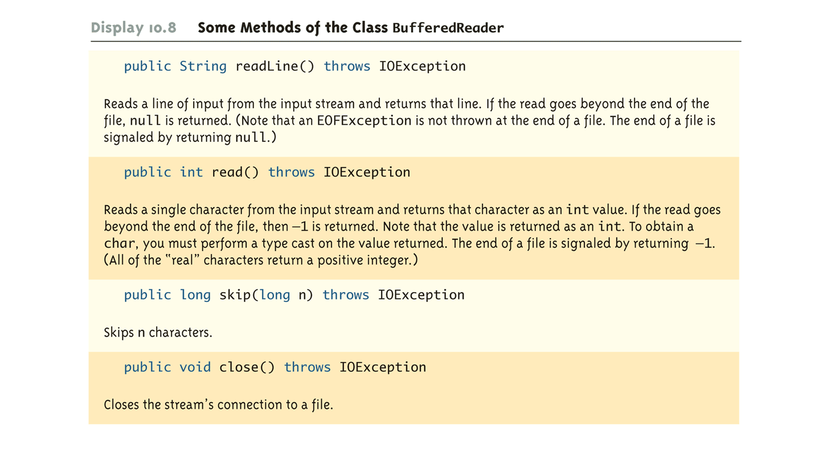
Some Methods of the Class BufferedReader (Part 2 of 2)

Slide 55
Reading Numbers
Unlike the Scanner class, the class BufferedReader has no methods to read a number from a text file
Instead, a number must be read in as a string, and then converted to a value of the appropriate numeric type using one of the wrapper classes
To read in a single number on a line by itself, first use the method readLine, and then use Integer.parseInt, Double.parseDouble, etc. to convert the string into a number
If there are multiple numbers on a line, StringTokenizer can be used to decompose the string into tokens, and then the tokens can be converted as described above

Slide 56
Testing for the End of a Text File
The method readLine of the class BufferedReader returns null when it tries to read beyond the end of a text file
A program can test for the end of the file by testing for the value null when using readLine
The method read of the class BufferedReader returns -1 when it tries to read beyond the end of a text file
A program can test for the end of the file by testing for the value -1 when using read

Slide 57
Path Names
When a file name is used as an argument to a constructor for opening a file, it is assumed that the file is in the same directory or folder as the one in which the program is run
If it is not in the same directory, the full or relative path name must be given

Slide 58
Path Names
A path name not only gives the name of the file, but also the directory or folder in which the file exists
A full path name gives a complete path name, starting from the root directory
A relative path name gives the path to the file, starting with the directory in which the program is located

Slide 59
Path Names
The way path names are specified depends on the operating system
A typical UNIX path name that could be used as a file name argument is
"/user/sallyz/data/data.txt"
A BufferedReader input stream connected to this file is created as follows:
BufferedReader inputStream =
new BufferedReader(new
FileReader("/user/sallyz/data/data.txt"));

Slide 60
Path Names
The Windows operating system specifies path names in a different way
A typical Windows path name is the following:
C:\dataFiles\goodData\data.txt
A BufferedReader input stream connected to this file is created as follows:
BufferedReader inputStream = new
BufferedReader(new FileReader
("C:\\dataFiles\\goodData\\data.txt"));
Note that in Windows \\ must be used in place of \, since a single backslash denotes an the beginning of an escape sequence

Slide 61
Path Names
A double backslash (\\) must be used for a Windows path name enclosed in a quoted string
This problem does not occur with path names read in from the keyboard
Problems with escape characters can be avoided altogether by always using UNIX conventions when writing a path name
A Java program will accept a path name written in either Windows or Unix format regardless of the operating system on which it is run

Slide 62
Binary Files
Binary files store data in the same format used by computer memory to store the values of variables
No conversion needs to be performed when a value is stored or retrieved from a binary file
Java binary files, unlike other binary language files, are portable
A binary file created by a Java program can be moved from one computer to another
These files can then be read by a Java program, but only by a Java program

Slide 63
Writing Simple Data to a Binary File
The class ObjectOutputStream is a stream class that can be used to write to a binary file
An object of this class has methods to write strings, values of primitive types, and objects to a binary file
A program using ObjectOutputStream needs to import several classes from package java.io:
import java.io.ObjectOutputStream;
import java.io.FileOutStream;
import java.io.IOException;

Slide 64
Opening a Binary File for Output
An ObjectOutputStream object is created and connected to a binary file as follows:
ObjectOutputStream outputStreamName = new
ObjectOutputStream(new
FileOutputStream(FileName));
The constructor for FileOutputStream may throw a FileNotFoundException
The constructor for ObjectOutputStream may throw an IOException
Each of these must be handled

Slide 65
Opening a Binary File for Output
After opening the file, ObjectOutputStream methods can be used to write to the file
Methods used to output primitive values include writeInt, writeDouble, writeChar, and writeBoolean
UTF is an encoding scheme used to encode Unicode characters that favors the ASCII character set
The method writeUTF can be used to output values of type String
The stream should always be closed after writing

Slide 66
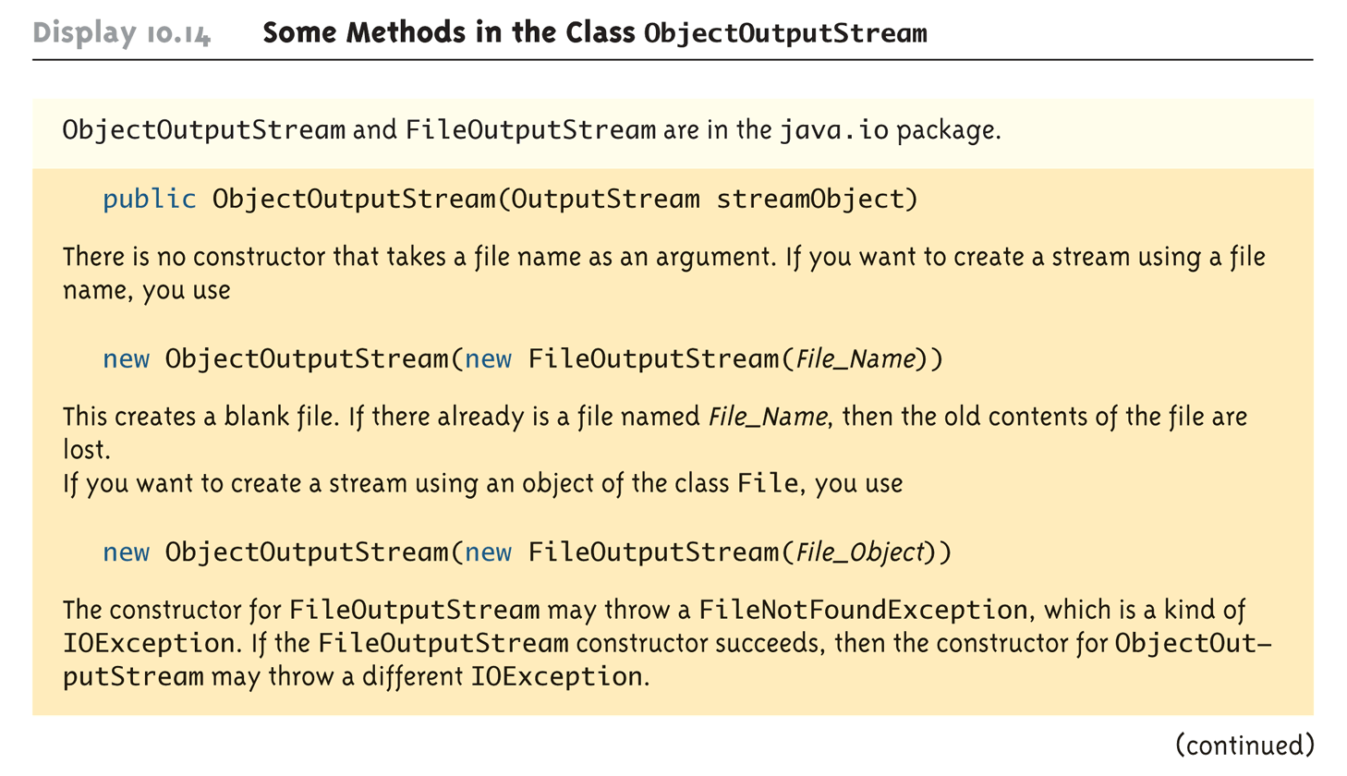
Some Methods in the Class ObjectOutputStream (Part 1 of 5)

Slide 67
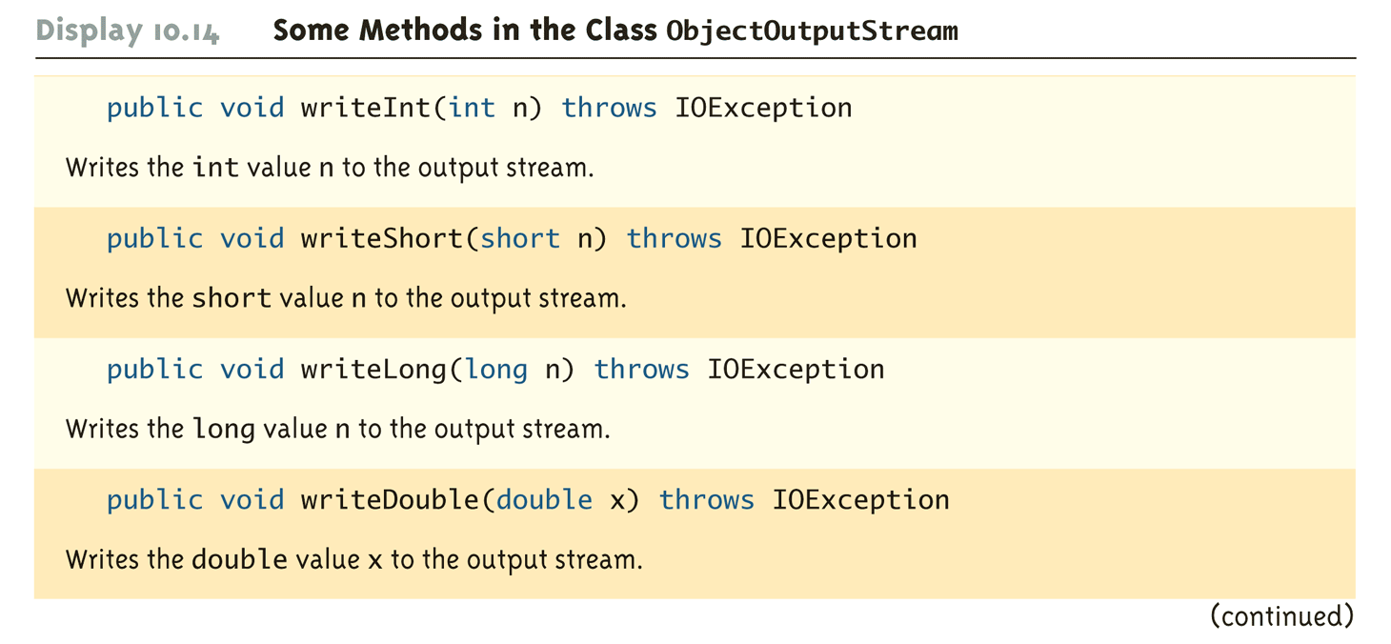
Some Methods in the Class ObjectOutputStream (Part 2 of 5)

Slide 68
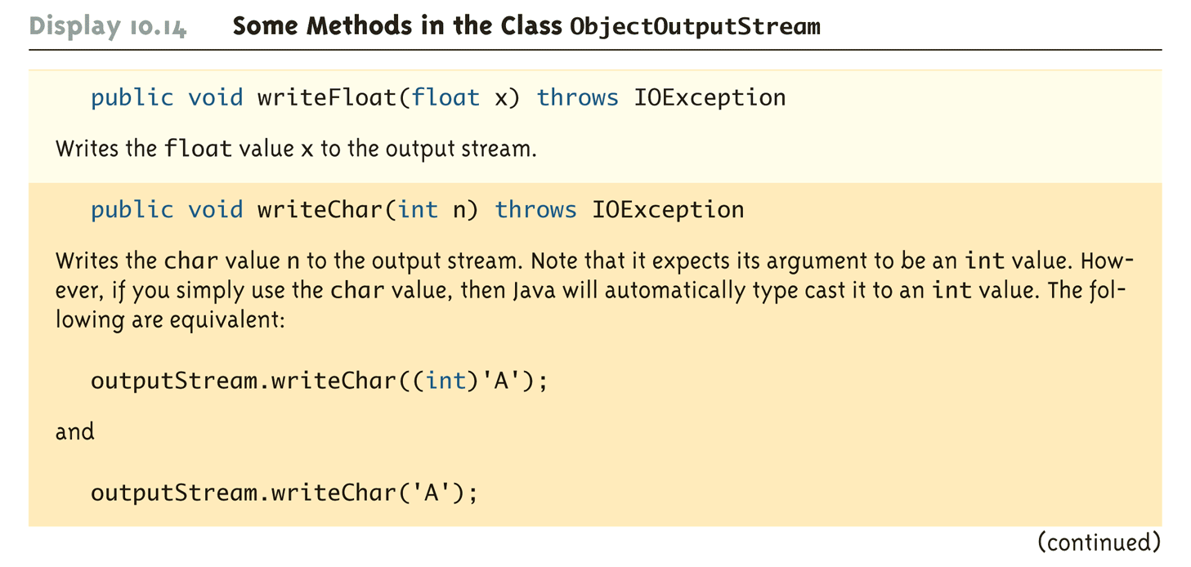
Some Methods in the Class ObjectOutputStream (Part 3 of 5)

Slide 69
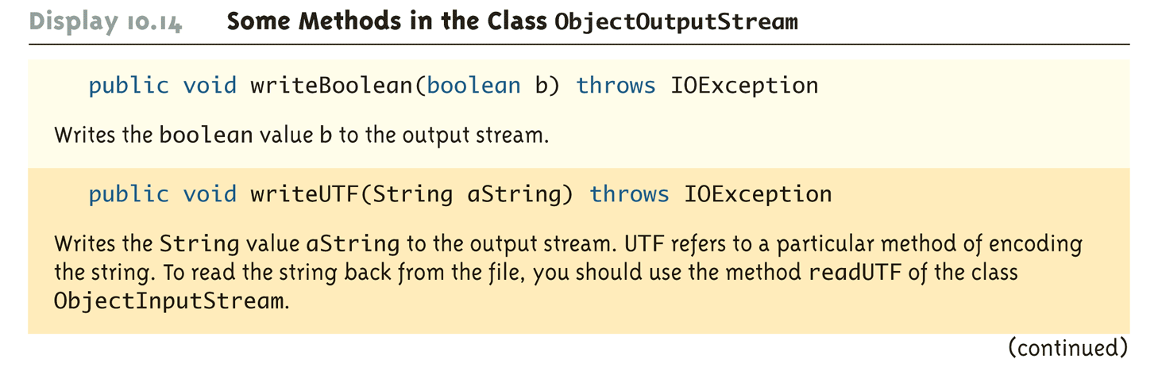
Some Methods in the Class ObjectOutputStream (Part 4 of 5)

Slide 70
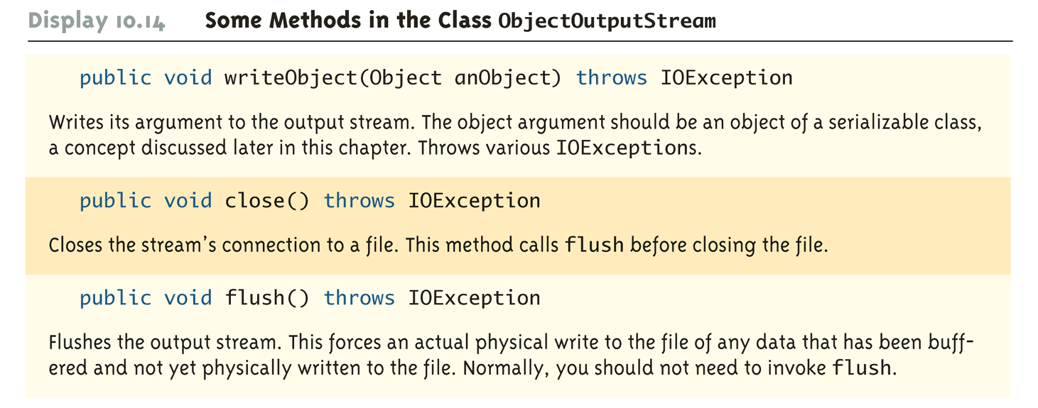
Some Methods in the Class ObjectOutputStream (Part 5 of 5)

Slide 71
Reading Simple Data from a Binary File
The class ObjectInputStream is a stream class that can be used to read from a binary file
An object of this class has methods to read strings, values of primitive types, and objects from a binary file
A program using ObjectInputStream needs to import several classes from package java.io:
import java.io.ObjectInputStream;
import java.io.FileInputStream;
import java.io.IOException;

Slide 72
Opening a Binary File for Reading
An ObjectInputStream object is created and connected to a binary file as follows:
ObjectInputStream inStreamName = new
ObjectInputStream(new
FileInputStream(FileName));
The constructor for FileInputStream may throw a FileNotFoundException
The constructor for ObjectInputStream may throw an IOException
Each of these must be handled

Slide 73
Opening a Binary File for Reading
After opening the file, ObjectInputStream methods can be used to read to the file
Methods used to input primitive values include readInt, readDouble, readChar, and readBoolean
The method readUTF is used to input values of type String
If the file contains multiple types, each item type must be read in exactly the same order it was written to the file
The stream should be closed after reading

Slide 74
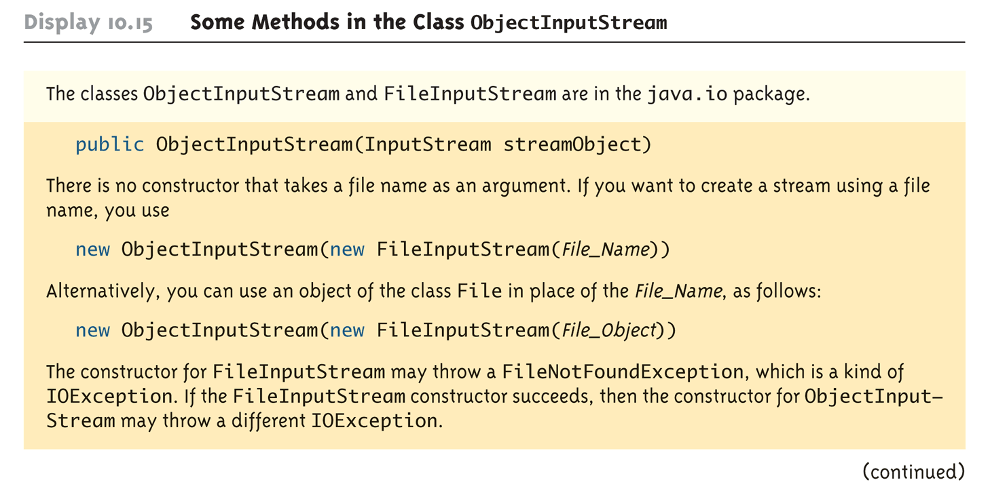
Some Methods in the Class ObjectInputStream (Part 1 of 5)

Slide 75
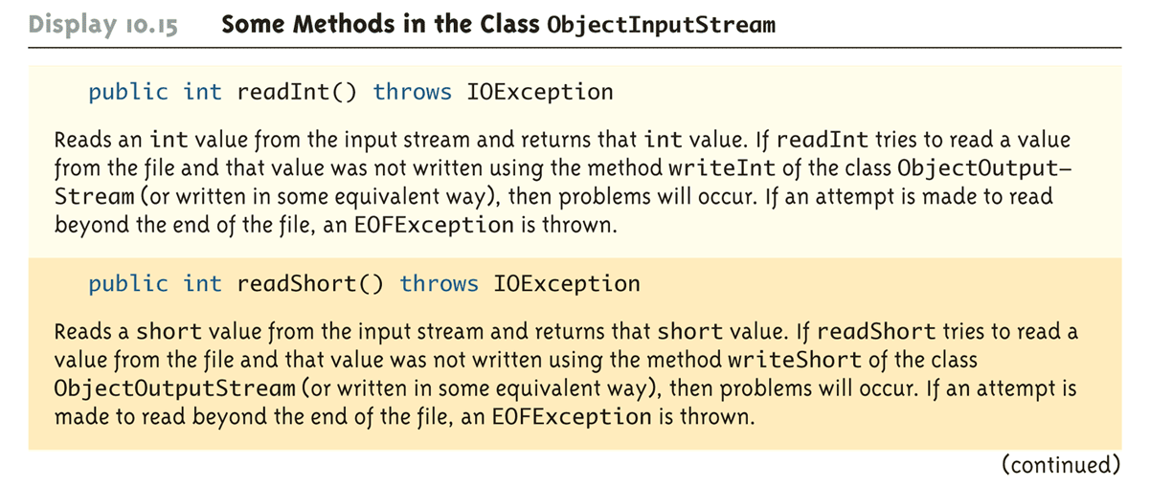
Some Methods in the Class ObjectInputStream (Part 2 of 5)

Slide 76
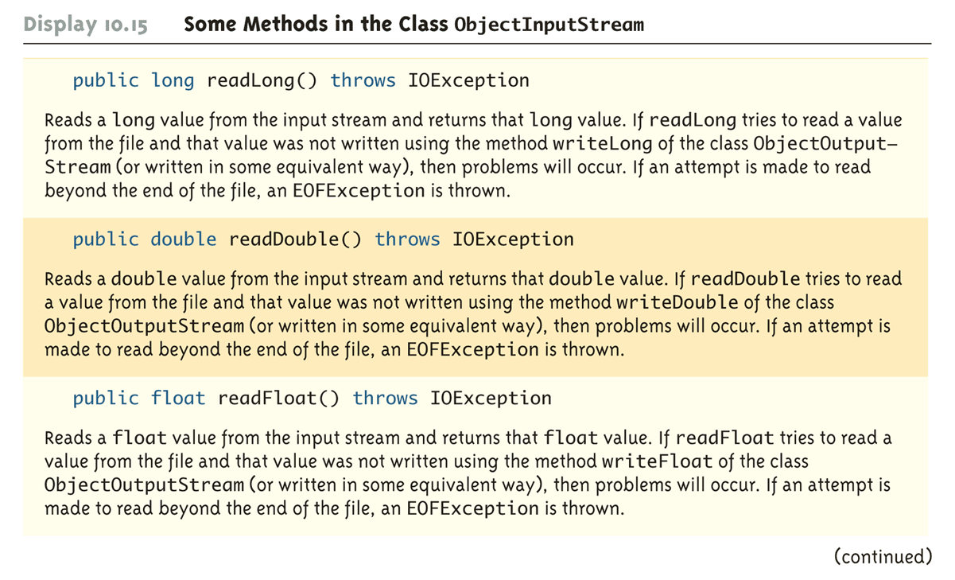
Some Methods in the Class ObjectInputStream (Part 3 of 5)

Slide 77
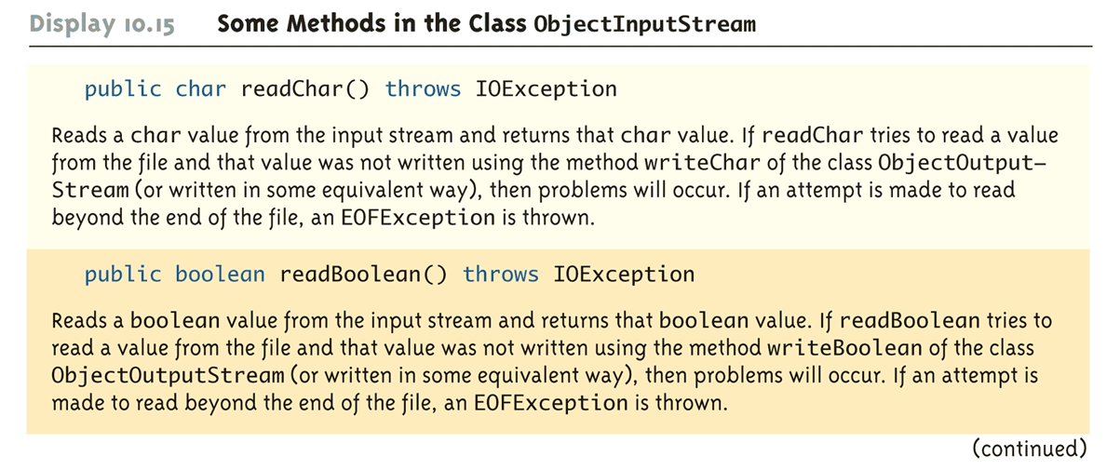
Some Methods in the Class ObjectInputStream (Part 4 of 5)

Slide 78
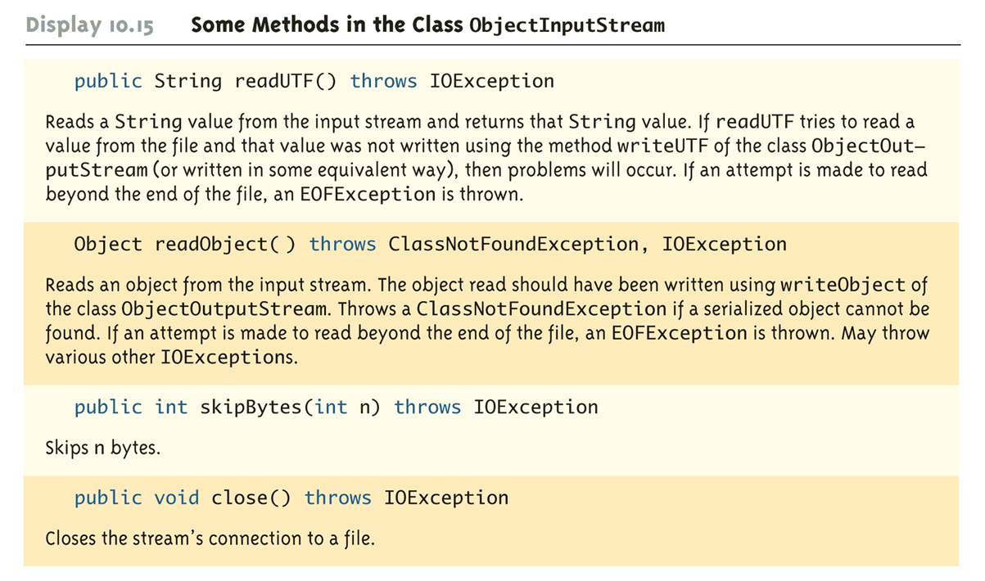
Some Methods in the Class ObjectInputStream (Part 5 of 5)

Slide 79
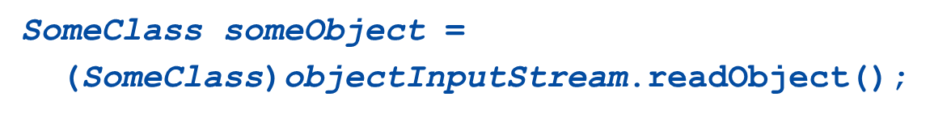
Binary I/O of Objects (1 of 2)
Objects can also be input and output from a binary file
Use the writeObject method of the class ObjectOutputStream to write an object to a binary file
Use the readObject method of the class ObjectInputStream to read an object from a binary file
In order to use the value returned by readObject as an object of a class, it must be type cast first:

Slide 80
Binary I/O of Objects (2 of 2)
It is best to store the data of only one class type in any one file
Storing objects of multiple class types or objects of one class type mixed with primitives can lead to loss of data
In addition, the class of the object being read or written must implement the Serializable interface
The Serializable interface is easy to use and requires no knowledge of interfaces
A class that implements the Serializable interface is said to be a serializable class

Slide 81
The Serializable Interface
In order to make a class serializable, simply add implements Serializable to the heading of the class definition
When a serializable class has instance variables of a class type, then all those classes must be serializable also
A class is not serializable unless the classes for all instance variables are also serializable for all levels of instance variables within classes

